Slide 1

PROJECT TITLE : SEASONAL AGRICULTURE PERFORMANCE ANAYLSIS
Student Name : Gudala Monika Priya
College Name : Sri Durga Malleswara Siddhartha Mahila Kalasala
AICTE STU ID : STU6847f627107151749546535
9/10/2026
Annual Review
1

Slide 2

PROBLEM STATEMENT
▪
Agricultural activities are influenced by seasonal variations
in environmental conditions, farming practices, resource
availability and market conditions. As a result, agricultural
performance may differ from one season to another.
However, raw agricultural data does not clearly explain
how agricultural performance changes across seasons or
what patterns can be observed in different seasonal
conditions. The problem is to analyze the given agricultural
dataset and investigate seasonal differences in agricultural
performance by identifying meaningful patterns, trends,
relationships and variations within the available data.
9/10/2026
Annual Review
2

Slide 3

Project Description
•
The Agricultural Seasonal Performance Analysis project is used to
understand how agricultural performance changes in different
seasons. Factors such as weather, farming methods, crop type, water
availability, and market conditions can affect crop production and
yield.
•
In this project, the agricultural dataset is cleaned and analyzed to find
patterns, trends, and differences between seasons. Data analysis and
visualization techniques are used to compare crop production and
yield across different seasons. The main goal of this project is to
identify which seasons have better agricultural performance and
understand the factors that influence crop production. The findings
can provide useful insights for making better decisions in agriculture.
9/10/2026
Annual Review
3

Slide 4


WHO ARE THE END USERS?
▪
The primary end users of this project are farmers, agricultural
organizations, government agriculture departments, agricultural
researchers, and agricultural planners. They can use the insights from
seasonal agricultural data to understand performance variations,
resource usage, environmental patterns, and economic outcomes,
which can support better seasonal agricultural planning.
▪
The end users of our project are mainly farmers, agricultural
organizations, government departments, and agricultural planners. They
can use our analysis to understand seasonal changes and make better
agricultural decisions.
9/10/2026
Annual Review
4

Slide 5

Technology Used
▪
Python – Used to do the main data analysis.
▪
Pandas – Used to load, clean, and organize the agricultural data.
▪
NumPy – Used for calculations and working with numbers.
▪
Matplotlib – Used to create simple graphs and charts.
▪
Seaborn – Used to create better-looking charts like box plots and heatmaps.
▪
SciPy – Used to perform statistical tests and compare seasons.
▪
Statsmodels – Used to perform advanced statistical analysis.
▪
Jupyter Notebook – Used to write the code, show the results, and document the
project.
9/10/2026
Annual Review
5

Slide 6
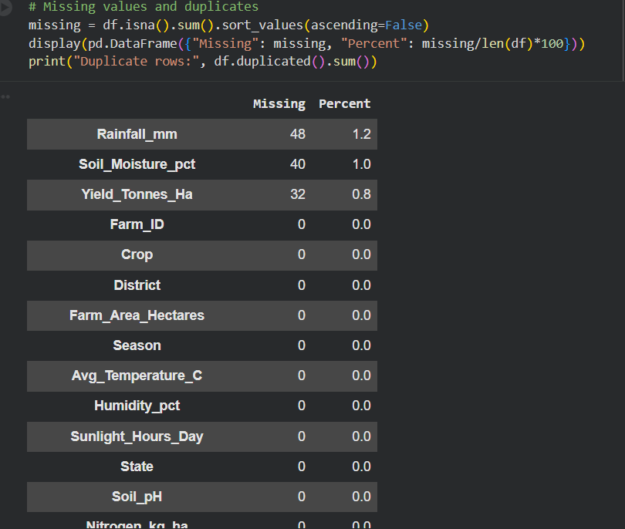
9/10/2026
Annual Review
6

Slide 7
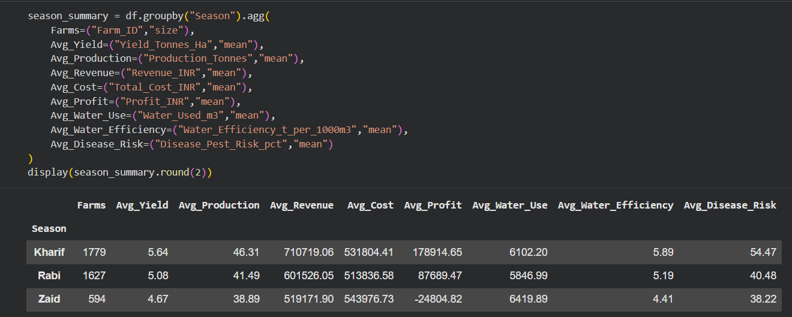
9/10/2026
Annual Review
8

Slide 8
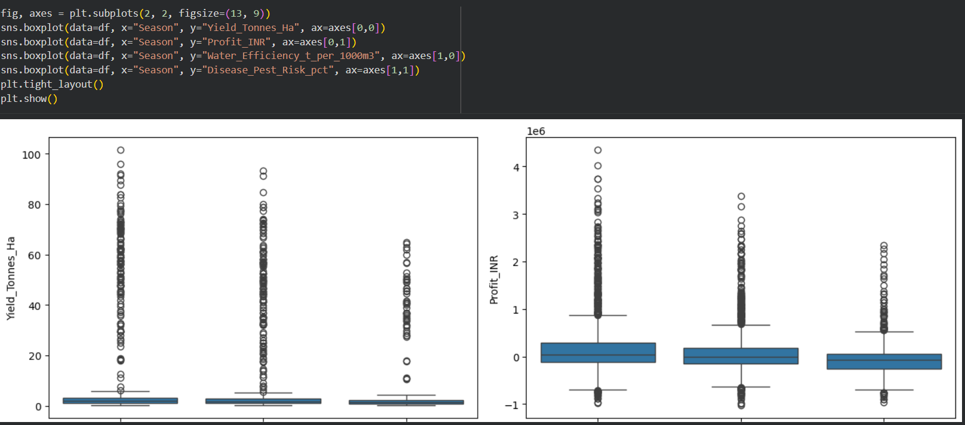
[Add screen shots of your code ]
9/10/2026
Annual Review
7

Slide 9
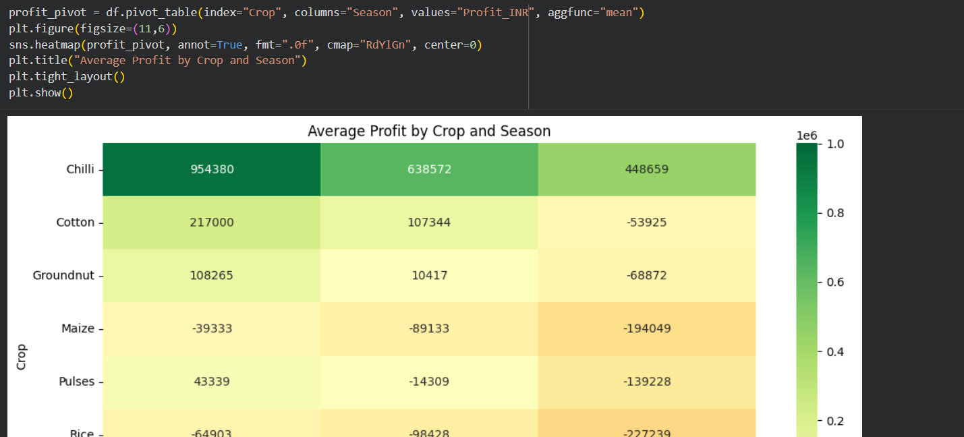
[Add screen shots of your code ]
9/10/2026
Annual Review
9

Slide 10
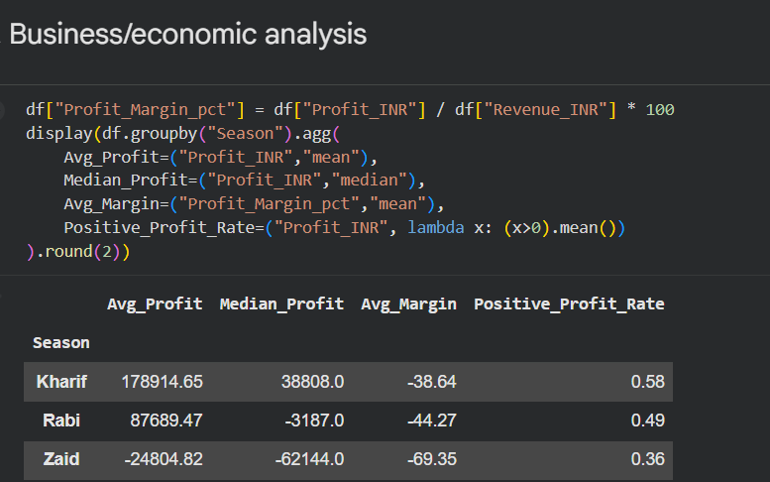
9/10/2026
Annual Review
10

Slide 11
Future scope
In the future, this project can be improved by adding more
agricultural data and using advanced technologies. We can
include weather and market data, use Machine Learning to
predict crop yield and prices, and create Power BI dashboards
for easy understanding. This can help farmers make better
decisions about which crop to grow, when to grow it, and how
to use resources efficiently.
9/10/2026
Annual Review
11

Slide 12
GitHub Link
https://github.com/AswiniKumar55/-Seasonal-Agriculture-
Performance-Analysis-.git
9/10/2026
Annual Review
12

Slide 13
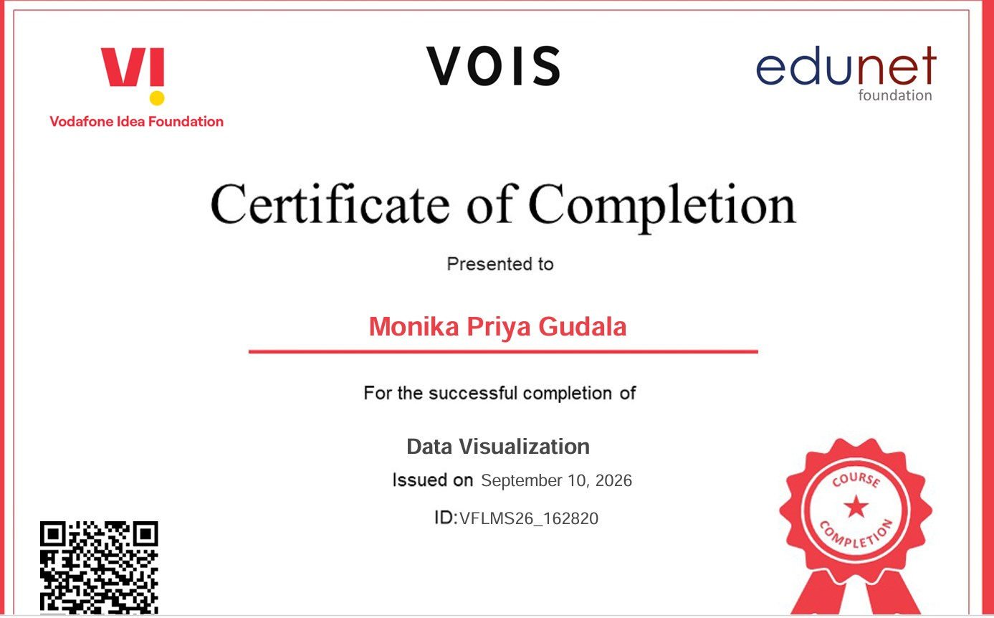
VOIS Course completion certificate - Data Visualization
9/10/2026
Annual Review
13

Slide 14

THANK YOU
.
.
9/10/2026
Annual Review
14

